Slide 1
Project Brief & Mid-Program Presentation
NYC Air Quality & Health Impacts
TEAM: Derick, Lupita, Guhfran

Slide 2

Problem Statement
Air Pollution and Health Inequities in NYC
Key Issues
Unequal exposure to air pollution across neighborhoods
Higher health risks in vulnerable communities
Impacts include asthma, heart disease, cancer, and premature death
Research Questions
How do PM₂.₅(Fine Particulate Matter), NO₂ (Nitrogen Dioxide), and O₃(Ozone (Ground-Level)) levels vary across NYC?
Are vulnerable populations exposed to higher pollution levels?
Can air quality data predict respiratory and cardiovascular health disparities?
How do pollution hotspots align with climate investment areas?
Notes:
PM₂.₅, NO₂, and O₃ are three of the most common and heavily monitored air pollutants used to calculate the Air Quality Index (AQI). When you see these numbers on a weather app or an air purifier, they are measuring different types of harmful substances in the air around you. [1, 2]
A direct breakdown of what each one means:
Pollutant
Full Name
What It Actually Is
Common Sources
Why It’s Dangerous
PM₂.₅Fine Particulate MatterMicroscopic solid particles or liquid droplets suspended in the air that are 2.5 micrometers or smaller in width. (About 30 times smaller than a human hair).Wildfires, wood-burning stoves, vehicle exhaust, and industrial smokestacks.Because they are so tiny, they can bypass your body's natural defenses, traveling deep into your lungs and even entering your bloodstream.
NO₂Nitrogen DioxideA highly reactive, toxic gas. In very high concentrations, it can look like a reddish-brown haze and has a sharp, acrid smell.Burning fossil fuels—primarily car emissions, trucks, power plants, and gas stoves.It severely inflames the respiratory tract, making breathing difficult and worsening conditions like asthma. It also reacts with other chemicals to form ozone and smog.
O₃Ozone (Ground-Level)A gas made of three oxygen atoms. While "good" ozone high up in the atmosphere shields us from the sun, ground-level ozone is a toxic pollutant.It is a "secondary pollutant" created when NO₂ and other chemicals bake in heat and sunlight.It acts as a powerful lung irritant, causing a "burning" sensation, coughing, and long-term lung tissue damage. Ozone levels are usually highest on sunny summer afternoons.

Slide 3
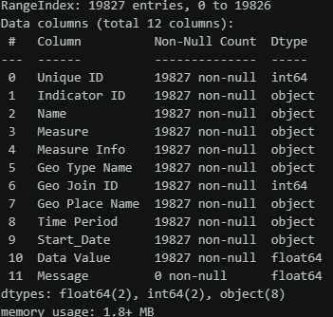
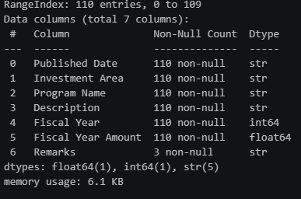
Data Profile & Scope
NYC Climate Budgeting Report: New Climate Investments And Reallocations In Executive Plan
Air Quality and Health Impacts
Notes:
NYC Department of Health and Mental Hygiene (DOHMH)
Environment & Health Data Portal and Real-Time Air Quality Feeds
Dataset Overview
Last Updated: June 18, 2026
Approximately 19,800 records
12 data attributes
Unit of Analysis
Individual air quality measurement
Indexed by a unique record ID
Geographic & Temporal Coverage
Multi-year air quality surveillance across New York City
Coverage includes:
Boroughs
Community Districts
UHF (United Hospital Fund) Neighborhoods
Key Strengths for Analysis
Fine-grained neighborhood-level monitoring
Supports spatial comparisons across NYC communities
Enables linkage between air quality indicators and public health outcomes
Suitable for equity and environmental justice analyses
NYC Office of Management and Budget (OMB)
Climate Budgeting Report: New Climate Investments and Reallocations in Executive Plan
Dataset Overview
Last Updated: June 2, 2026
Approximately 110 records
7 data attributes
Unit of Analysis
Individual climate investment or funding allocation by program and fiscal year
Coverage
New York City climate-related capital and expense investments
Annual fiscal year reporting
Key Strengths
Tracks new and reallocated climate funding
Distinguishes capital versus expense investments
Supports climate budget and funding trend analysis
Enhances transparency of NYC climate spending
Data Provider
Office of Management and Budget (OMB)
Update Frequency: Annually

Slide 4
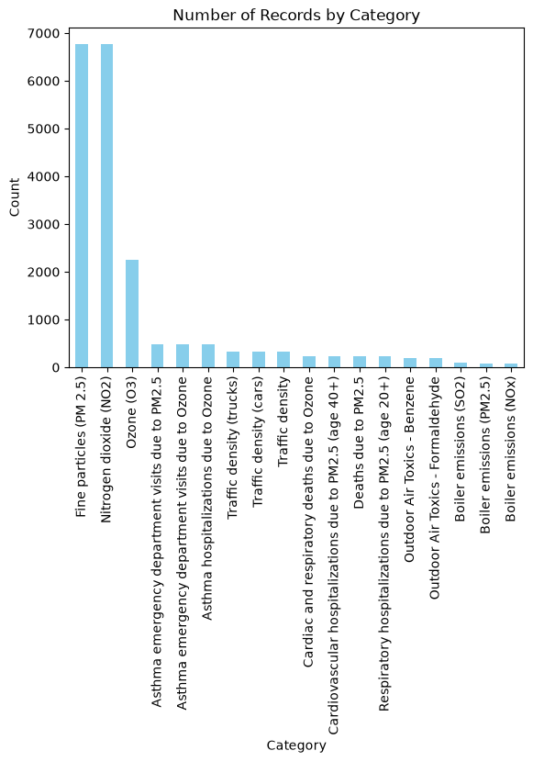
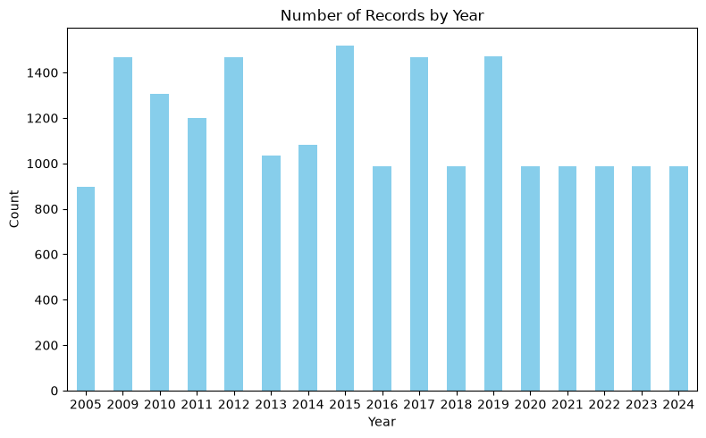
Initial EDA & Visuals
Air Quality and Health Impacts

Slide 5
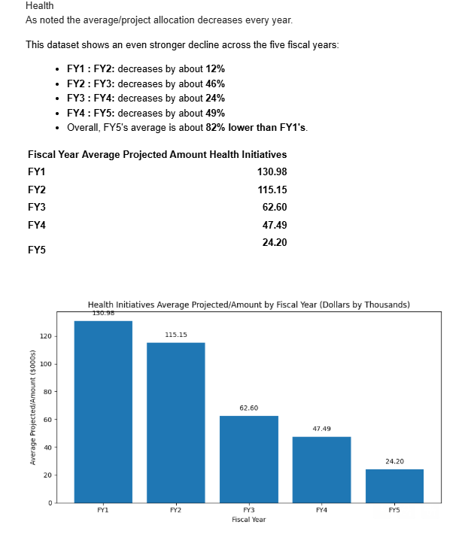
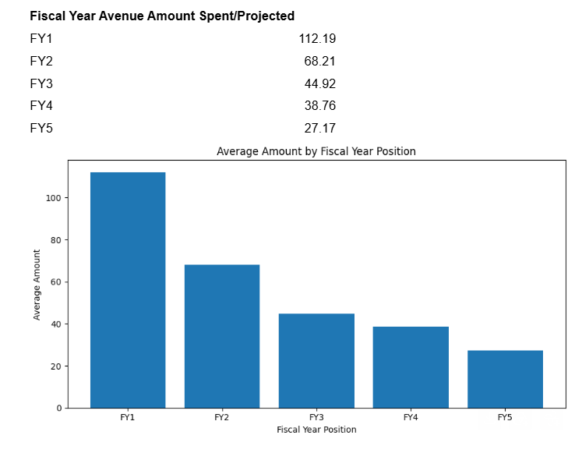
Initial EDA & Visuals
NYC Climate Budgeting Report: New Climate Investments And Reallocations In Executive Plan

Slide 6
Modeling Plan & Synthesis
2. Correlation & Spatial Analysis
Assess relationships between air pollution and health outcomes
Analyze associations with:
  Asthma-related ED visits
  Cardiovascular ED visits
Identify geographic hotspots and spatial patterns
3. Predictive Modeling & Health Disparity Assessment
Develop multivariate and spatial regression models
Control for:
  Poverty
  Demographic vulnerability
  Traffic exposure
Identify neighborhoods with disproportionate health impacts
1. Data Preparation & Spatial Harmonization
Aggregate air quality measurements into annual and seasonal neighborhood averages
Standardize geography across:
  UHF Neighborhoods
  Community Districts
  City Council Districts
Create a unified spatial framework for analysis

Slide 7
Open Questions & Repo Link
Project Repository: https://github.com/derickh-nyu/NYU-Tandon-Career-Hub-Fall-2026-Data-Science-Bootcamp-Group-Project.git
THANK YOU!

